Slide 1
Managing the ASM Instance

Slide 2
Objectives
After completing this lesson, you should be able to:
  Describe the benefits of using ASM
  Manage the ASM instance
  Create and Drop ASM disk groups
  Extend ASM disk groups
  Retrieve ASM metadata using various utilities
Notes:
Oracle Database 11g: Administration Workshop II D - <number>
Objectives
This lesson provides a more detailed look at the ASM instance and how to manage it with various utilities.

Slide 3
ASM Benefits for Administrators
ASM eliminates:
  I/O performance tuning
  Data file movements and reorganizations
  File name management
  Logical volume
  management
  File system management
  Cluster file system management
  Raw device management
ASM significantly reduces:
  LUN management
    Fewer, larger LUNs
  Database administrator dependence on system administrator
  Likelihood of errors associated with manual maintenance tasks
Notes:
Oracle Database 11g: Administration Workshop II D - <number>
ASM Benefits for Administrators
ASM eliminates the need for many tasks that are required in non-ASM storage environments. There include:
I/O performance tuning - ASM's stripe and mirror everything policy coupled with automatic rebalancing operations means that I/O performance tuning aimed at balancing disk utilization and eliminating disk hot-spots is not required.
Data file movements and reorganizations - Juggling the placement of data files to satisfy performance requirements and space constraints is not required.
File name management - You no longer need to define and enforce a file naming policy.
Logical volume, file system, cluster file system and raw device management - You no longer require these storage elements.
ASM delivers further benefits by reducing effort in these important areas:
LUN management effort is reduced as ASM will typically require fewer, larger, LUNs.
The dependence that often exists between a database administrator and a system administrator is greatly reduced. For example, system administrator involvement is not required to add a new data file or move disk resources from one disk group to another.
The likelihood of errors associated with manual maintenance tasks is greatly reduced. For example, using a conventional file system a newly created data file may accidentally break a file naming convention that results in it not being backed up with the rest of the database.

Slide 4
ASM Instance
The ASM Instance is the process and memory components for ASM.
System Global Area (SGA) – memory
Shared
Pool
Large
Pool
ASM
Cache
Free
Memory
Processes – CPU components
RBAL
ARBn
GMON
Onnn
PZ9n
MARK
Other misc. processes
ASM Instance
Notes:
Oracle Database 11g: Administration Workshop II D - <number>
ASM Instance
Every time ASM or a database is started, a shared memory area called the system global area (SGA) is allocated and Oracle ASM or database background processes are started. The combination of the background processes and the SGA is called an Oracle ASM instance or an Oracle Database instance. The instance represents the CPU and RAM components of a running ASM environment.
The SGA in an ASM instance is different in memory allocation and usage than the SGA in a database instance. The SGA in the ASM instance is divided into four primary areas as follows:
Shared Pool: Used for metadata information
Large Pool: Used for parallel operations
ASM Cache: Used for reading and writing blocks during rebalance operations
Free Memory: Unallocated memory available
The minimum recommended amount of memory for an ASM instance is 256 MB. Automatic memory management is enabled by default on an ASM instance and will dynamically tune the sizes of the individual SGA memory components. The amount of memory that is needed for an ASM instance will depend on the amount of disk space being managed by ASM.
The second part of the ASM instance is the background processes. An ASM instance can have many background processes; not all are always present.

Slide 5
Notes:
ASM Components: ASM Instance (continued)
The background processes specific to ASM functionality are covered in the next slide. There are required background processes and optional background processes. Some of these processes may include the following:
ARCn: The archiver processes
CKPT: The checkpoint process
DBWn: The database writer processes
DIAG: The diagnosability process
Jnnn: Job queue processes
LGWR: The log writer process
PMON: The process monitor process
PSP0: The process spawner process
QMNn: The queue monitor processes
RECO: The recoverer process
SMON: The system monitor process
VKTM: The virtual keeper of time process
MMAN: The memory manager process
The above list of processes in not complete. For the ASM instance, these processes will not always perform the same tasks as they would in a database instance. For example, the LGWR process in a database instance is responsible for copying change vectors from the log buffer section of the SGA to the online redo logs on disk. The ASM instance does not contain a log buffer in it’s SGA, nor does it use online redo logs. The LGWR process in an ASM instance copies logging information to an ASM disk group.
If ASM is clustered, then additional processes related to cluster management will be running in the ASM instance. Some of these processes include the following:
LMON: The global enqueue service monitor process
LMDn: The global enqueue service daemons
LMSn: The global cache service processes
LCKn: The lock processes

Slide 6
ASM Components:
ASM Instance—Primary Processes
The ASM instance primary processes are responsible for ASM-related activities.
Process | Description
RBAL | Opens all device files as part of discovery and coordinates the rebalance activity
ARBn | One or more slave processes that do the rebalance activity
GMON | Responsible for managing the disk-level activities such as drop or offline and advancing the ASM disk group compatibility
MARK | Marks ASM allocation units as stale when needed
Onnn | One or more ASM slave processes forming a pool of connections to the ASM instance for exchanging messages
PZ9n | One or more parallel slave processes used in fetching data on clustered ASM installation from GV$ views
Notes:
Oracle Database 11g: Administration Workshop II D - <number>
ASM Components: ASM Instance—Primary Processes
The ASM instance uses dedicated background processes for much of its functionality. The RBAL process coordinates rebalance activity for disk groups in an Automatic Storage Management instance. It performs a global open on Automatic Storage Management disks. The ARBn processes perform the actual rebalance data extent movements in an Automatic Storage Management instance. There can be many of these at a time, called ARB0, ARB1, and so on. The GMON process maintains disk membership in ASM disk groups. The MARK process marks ASM allocation units as stale following a missed write to an offline disk. The Onnn processes represent the server side of a client/server connection. These processes will appear the moment the instance is started, and will disappear after that. They form a pool of connections to the ASM instance for exchanging messages and only appear when needed. The PZ9n processes represent one or more parallel slave processes that are used in fetching data when ASM is running in a clustered configuration on more than one machine concurrently.

Slide 7
ASM Instance Initialization Parameters
The ASM instance uses a small subset of the parameters that an Oracle Database instance uses.
INSTANCE_TYPE = ASM
ASM_POWER_LIMIT = 1
ASM_DISKSTRING = '/dev/sda1','/dev/sdb*'
ASM_DISKGROUPS = DATA2, FRA
ASM_PREFERRED_READ_FAILURE_GROUPS = DATA.FailGroup2
DIAGNOSTIC_DEST = /u01/app/oracle
LARGE_POOL_SIZE = 12M
REMOTE_LOGIN_PASSWORDFILE = EXLUSIVE
Notes:
Oracle Database 11g: Administration Workshop II D - <number>
ASM Instance Initialization Parameters
An ASM instance is controlled by a parameter file in the same way as a regular database instance. Parameters commonly set there include:
INSTANCE_TYPE should be set to ASM for ASM instances. This is the only parameter that must be defined. For database instances, this is set to the value RDBMS.
ASM_POWER_LIMIT controls the speed for a rebalance operation. Values range from 1 through 11, with 11 being the fastest. If omitted, this value defaults to 1.
ASM_DISKSTRING is an operating system–dependent value used by ASM to limit the set of disks considered for discovery. The default value is the null string, and this will be sufficient in most cases. A more restrictive value as shown above may reduce the time required for ASM to perform discovery, and thus improve disk group mount times.
ASM_DISKGROUPS is the list of names of disk groups to be mounted by an ASM instance at startup, or when the ALTER DISKGROUP ALL MOUNT command is used. Oracle Restart can mount disk groups if they are listed as dependencies even if they are not listed with the ASM_DISKGROUPS parameter. This parameter has no default value.
ASM_PREFERRED_READ_FAILURE_GROUPS specifies the failure groups that contain preferred read disk. This is useful in extended or stretched cluster databases that have mirrored copies of data with one of the copies in close proximity to the server.

Slide 8
Notes:
ASM Instance Initialization Parameters (continued)
DIAGNOSTIC_DEST specifies the location of the Automatic Diagnostic Repository (ADR) home. Trace files, alert logs, core files, and incident files can be found under this directory. The default value of this parameter is derived from the value of ORACLE_BASE.
LARGE_POOL_SIZE specifies (in bytes) the size of the large pool allocation heap. The large pool allocation heap is used in shared server systems for session memory, by parallel execution for message buffers, and by backup processes for disk I/O buffers. The ASM instance makes use of automatic memory management, so this parameter serves as a minimum size that the large pool can lowered to.
REMOTE_LOGIN_PASSWORDFILE specifies whether the Oracle software checks for a password file. The default value is EXCLUSIVE.
The eight parameters listed above are the only non-default parameters created for an ASM instance. The ASM instance differs from a database instance in that not all database parameters are valid for an ASM instance. Approximately 74 of the 344 total database instance parameters can be used with an ASM instance. The remaining parameters not listed on this can be set as needed, although default values should be sufficient for most installations.
Note: Automatic memory management is enabled by default on ASM instances, even when the MEMORY_TARGET parameter is not explicitly set. This is the only parameter that you need to set for complete ASM memory management. Oracle Corporation strongly recommends that you use automatic memory management for ASM.

Slide 9
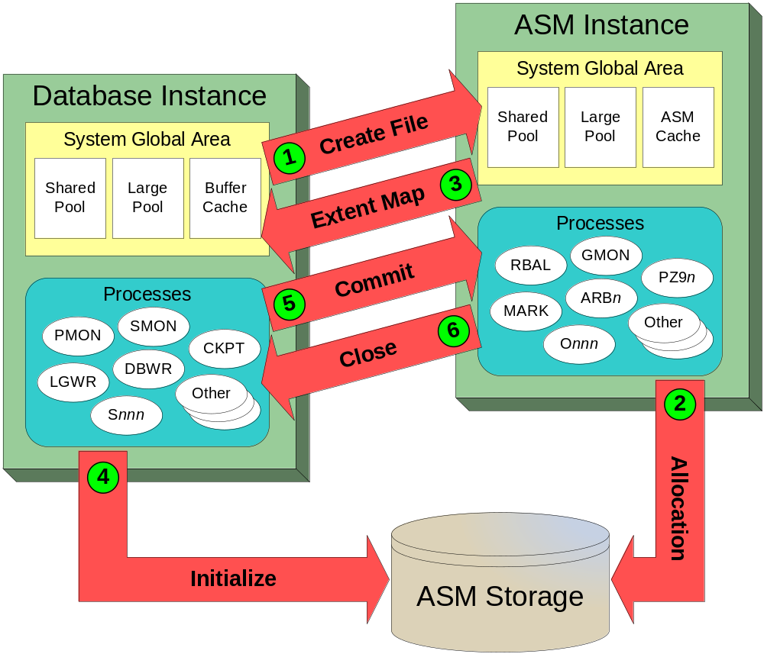
Interaction Between Database Instances and ASM
Screen reader hint: This slide contains a diagram that is explained in the speaker notes.
Notes:
Interaction Between Database Instances and ASM
The file creation process provides a fine illustration of the interactions that take place between database instances and ASM. The file creation process occurs as follows:
1. The database requests file creation.
2. An ASM foreground process creates a Continuing Operation Directory (COD) entry and allocates space for the new file across the disk group.
3. The ASMB database process receives an extent map for the new file.
4. The file is now open and the database process initializes the file directly.
5. After initialization, the database process requests that the file creation is committed. This causes the ASM foreground process to clear the COD entry and mark the file as created.
6. Acknowledgement of the file commit implicitly closes the file. The database instance will need to reopen the file for future I/O.
This example reinforces two important points about the architecture of ASM:
The Database Instance and ASM Instance work together in a coordinated fashion. A Database instance must interact with ASM to map database files to ASM extents. A Database instance also receives a constant stream of messages relating to ASM operations (such as disk group rebalancing) that may lock or move ASM extents.
Database I/O is not channeled through the ASM instance. In fact, the database conducts I/O operations directly against ASM files, as illustrated in step 4 in the slide.

Slide 10
ASM Instance: Dynamic Performance Views
The ASM instance hosts memory-based metadata tables presented as dynamic performance views.
  Accessed by ASM utilities to retrieve metadata-only information using the SQL language
  Contains many dedicated ASM related views such as:
V$ASM_ALIAS V$ASM_ATTRIBUTE V$ASM_CLIENT
V$ASM_DISK V$ASM_DISK_IOSTAT V$ASM_DISK_STAT
V$ASM_DISKGROUP V$ASM_DISKGROUP_STAT V$ASM_FILE
V$ASM_OPERATION V$ASM_TEMPLATE
Notes:
Oracle Database 11g: Administration Workshop II D - <number>
ASM Instance: Dynamic Performance Views
One of the major functions of any instance is the storage of memory-based metadata tables. These tables start with the prefix X$ and are generally not documented. A series of dynamic performance views that start with the prefix V$ are used to display a customized presentation of the data contained in the X$ memory tables. The information is presented in a read-only fashion available only to administrators with privileges. The information is retrieved from ASM using the SQL language. The above slide lists the most common dynamic performance views that contain ASM-related metadata. There are several hundred additional dynamic performance views, but most of these views will be empty because they require a database instance to mount a database control file. ASM instances do not mount database control files. For a complete list of the dynamic performance views, see the Oracle Database Reference 11g Release 2 (11.2) documentation manual.

Slide 11
ASM System Privileges
  An ASM instance does not have a data dictionary, so the only way to connect to ASM is by using these system privileges.
  SYS user is automatically created with the SYSASM privilege.
ASM Privilege | Privilege Group (Suggested) | Privilege
SYSASM | OSASM (asmadmin) | Full administrative privilege
SYSDBA | OSDBA (asmdba) | Access to data stored on ASM, and SYSASM in the current release
SYSOPER | OSOPER (asmoper) | Limited privileges to start and stop the ASM instance along with a set of nondestructive ALTER DISKGROUP commands
Notes:
ASM System Privileges
An ASM instance does not have a data dictionary, so the only way to connect to an ASM instance is by using one of three system privileges, SYSASM, SYSDBA, or SYSOPER. The following list introduces these ASM system privileges.
SYSASM: This privilege provides full administrative privilege for the ASM instance.
SYSDBA: This privilege grants access to data stored on ASM, and in the current release, grants the SYSASM administrative privileges.
SYSOPER: This privilege grants the ability to start and stop ASM instances along with a set of nondestructive ALTER DISKGROUP commands. Other commands such as CREATE DISKGROUP are not allowed.
When ASM is installed, operating system groups are assigned the SYSASM, SYSDBA, and SYSOPER privileges. These groups are known as the OSASM, OSDBA, and OSOPER groups, respectively. Membership of these operating system groups automatically assigns the related system privileges to the operating system user in question
When an ASM instance is first created, sys and asmsnmp are the only ASM users that are defined.

Slide 12
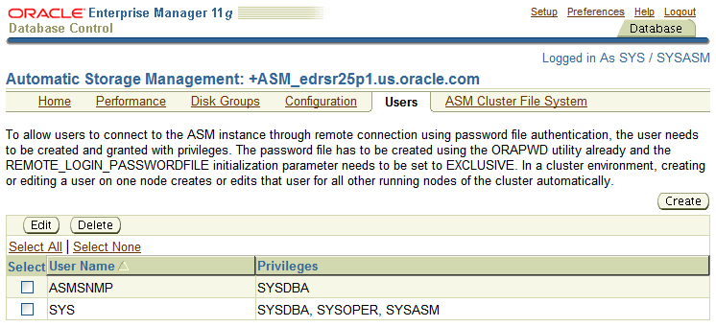
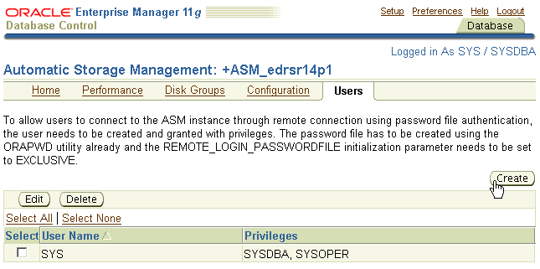
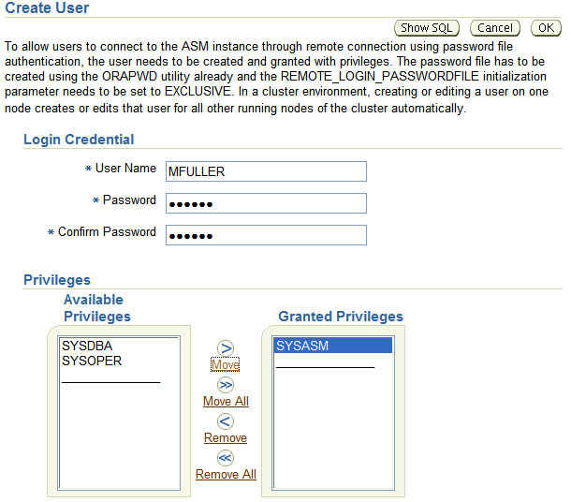
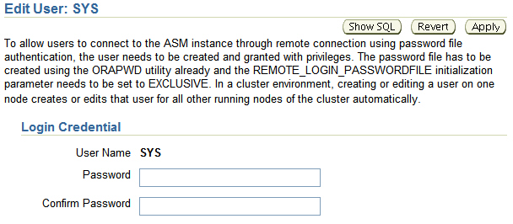
Using Enterprise Manager to Manage ASM Users
Notes:
Using Enterprise Manager to Manage ASM Users
Enterprise Manager allows you to manage the users who access the ASM instance through remote connection (using password file authentication). These users are reserved exclusively for the ASM instance.
You have this functionality only when you are connected as the SYSASM user. It is hidden if you connect as SYSDBA or SYSOPER users.
When you click the Create button, the Create User page is displayed.
When you click the Edit button the Edit User page is displayed.
By clicking the Delete button, you can delete the created users.
Note: To login to ASM with the SYSASM role, click the Preferences link at the top of the page, followed by the Preferred Credentials link. You will then see ASM in the list of target types. Click the Set Credentials icon beside the ASM target type to define an account and password that has the SYSASM privilege. You may need to log out of Database Control and login before the change takes effect.

Slide 13
Starting and Stopping ASM Instances
Using SQL*Plus
Starting and stopping ASM instances using SQL*Plus is similar to the way in which you start and stop database instances.
$ . oraenv
ORACLE_SID = [orcl] ? +ASM
The Oracle base for ORACLE_HOME=/u01/app/oracle/product/11.2.0/grid is /u01/app/oracle
$ sqlplus / AS SYSASM
SQL*Plus: Release 11.2.0.1.0 - Production on Wed Jul 8 20:46:46 2009
Copyright (c) 1982, 2009, Oracle. All rights reserved.
Connected to an idle instance.
SQL> startup
ASM instance started
Total System Global Area 284565504 bytes
Fixed Size 1336028 bytes
Variable Size 258063652 bytes
ASM Cache 25165824 bytes
ASM diskgroups mounted
ASM diskgroups volume enabled
SQL> shutdown abort
Notes:
Starting and Stopping ASM Instances Using SQL*Plus
With SQL*Plus you start an ASM instance by using the STARTUP command similarly to the way in which you start an Oracle Database instance. When starting an ASM instance, note the following:
To connect to an ASM instance with SQL*Plus, set the ORACLE_SID environment variable to the ASM SID. The default ASM SID for a single instance database is +ASM, and the default SID for ASM for an Oracle RAC node is +ASMnode_number where node_number is the number of the node. The oraenv script will set the ORACLE_BASE, ORACLE_SID, ORACLE_HOME and PATH variables.
The initialization parameter file must contain the following entry:
INSTANCE_TYPE = ASM
This parameter indicates that an ASM instance, not a database instance, is starting.
When you run the STARTUP command, rather than trying to mount and open a database, this command attempts to mount the disk groups specified by the initialization parameter ASM_DISKGROUPS. If you have not entered a value for ASM_DISKGROUPS, you can later mount disk groups with the ALTER DISKGROUP...MOUNT command.

Slide 14
Notes:
Starting and Stopping ASM Instances Using SQL*Plus (continued)
The following list describes the STARTUP command parameters relevant to ASM.
FORCE: Issues a SHUTDOWN ABORT to the ASM instance before restarting it
MOUNT or OPEN: Mounts the disk groups specified in the ASM_DISKGROUPS initialization parameter. This is the default if no command parameter is specified.
NOMOUNT: Starts up the ASM instance without mounting any disk groups
RESTRICT: Starts up an instance in restricted mode. The RESTRICT clause can be used in combination with the MOUNT, NOMOUNT, and OPEN clauses.
In restricted mode, database instances cannot use the disk groups. That is, databases cannot open files that are in that disk group. Also, if a disk group is mounted by an instance in restricted mode, then that disk group cannot be mounted by any other instance in the cluster. Restricted mode enables you to perform maintenance tasks on a disk group without interference from clients. Rebalance operations that occur while a disk group is in restricted mode eliminate the lock and unlock extent map messaging that occurs between ASM instances in a clustered environment. This improves the overall rebalance throughput. At the end of a maintenance period, you must explicitly dismount the disk group and remount it in normal mode.
The ASM shutdown process is initiated when you run the SHUTDOWN command in SQL*Plus. Before you run this command, ensure that the ORACLE_SID and ORACLE_HOME environment variables are set so that you can connect to the ASM instance.
Oracle strongly recommends that you shut down all database instances that use the ASM instance before attempting to shut down the ASM instance.
The following list describes the SHUTDOWN command parameters relevant to ASM.
NORMAL: ASM waits for any in-progress SQL to complete before dismounting all of the disk groups and shutting down the ASM instance. Before the instance is shut down, ASM waits for all of the currently connected users to disconnect from the instance. If any database instances are connected to the ASM instance, then the SHUTDOWN command returns an error and leaves the ASM instance running. NORMAL is the default shutdown mode.
IMMEDIATE or TRANSACTIONAL: ASM waits for any in-progress SQL to complete before dismounting all of the disk groups and shutting down the ASM instance. ASM does not wait for users currently connected to the instance to disconnect. If any database instances are connected to the ASM instance, then the SHUTDOWN command returns an error and leaves the ASM instance running.
ABORT: The ASM instance immediately shuts down without the orderly dismount of disk groups. This causes recovery to occur upon the next ASM startup. If any database instance is connected to the ASM instance, then the database instance aborts.
Note: The NORMAL, IMMEDIATE, and TRANSACTIONAL forms of shutdown do not apply when there are connected RDBMS instances. The following error will be returned:
ORA-15097: cannot SHUTDOWN ASM instance with connect RDBMS instance

Slide 15
Starting and Stopping ASM Instances
Using srvctl
  The Sever Control utility (srvctl) can be used to start and stop ASM instances.
  The Sever Control utility (srvctl) can be used to check the status of ASM instances.
$ . oraenv
ORACLE_SID = [orcl] ? +ASM
The Oracle base for ORACLE_HOME=/u01/app/oracle/product/11.2.0/grid is /u01/app/oracle
$ srvctl start asm -o mount
$ srvctl stop asm -f
$ srvctl status asm
ASM is running on edrsr25p1
Notes:
Starting and Stopping ASM Instances Using srvctl
The Server Control utility (srvctl) can be used to start and stop ASM instances along with other resources managed by the Grid Infrastructure. The srvctl utility can be found under both the ORACLE_HOME/bin location for Grid infrastructure and the ORACLE_HOME/bin location of the database installation. You should use the srvctl utility located with the Grid Infrastructure installation when managing ASM, listeners, or Oracle restart. The srvctl utility can be used to control ASM in the following ways:
Start an ASM instance.
srvctl start asm [-o <start_option>]
<start_option> is one the valid instance startup options
(FORCE, MOUNT, OPEN, NOMOUNT or RESTRICT) (optional)
Stop an ASM instance.
srvctl stop asm [-o <stop_option>] -f
<stop_option> is one the valid instance shutdown options
(NORMAL, IMMEDIATE, TRANSACTIONAL or ABORT) (optional), and –f is to force
Report the status of an ASM instance.
srvctl status asm

Slide 16
Starting and Stopping ASM Instances
Using asmcmd
The asmcmd utility provides a command line interface to ASM without using the SQL language.
$ . oraenv
ORACLE_SID = [orcl] ? +ASM
The Oracle base for ORACLE_HOME=/u01/app/oracle/product/11.2.0/grid is /u01/app/oracle
$ asmcmd
Connected to an idle instance.
ASMCMD> startup
ASM instance started
Total System Global Area 284565504 bytes
Fixed Size 1336028 bytes
Variable Size 258063652 bytes
ASM Cache 25165824 bytes
ASM diskgroups mounted
ASM diskgroups volume enabled
ASMCMD> shutdown --abort
ASM instance shut down
Connected to an idle instance.
Notes:
Starting and Stopping ASM Instances Using asmcmd
ASM metadata for administration is found inside the dynamic performance views that are contained within the ASM instance. These views are usually accessed with an ASM utility using the SQL language. The requirement for knowledge of the SQL language increases the learning curve for mastering ASM, and SQL language training is not a normal requirement in the learning path of a systems administrator or storage administrator. The asmcmd utility provides a pseudo-shell-like environment that accepts UNIX-style syntax for common ASM administration tasks. It can be used to manage Oracle ASM instances, disk groups, file access control for disk groups, files and directories within disk groups, templates for disk groups, and volumes.
You can use the asmcmd utility to startup and shutdown your ASM instance. The supported startup options include:
--nomount (To start the ASM instance without mounting disk groups)
--restrict (To start the ASM instance and restrict database usage)
--pfile <pfile.ora> (To start the ASM instance with a custom pfile)
The supported shutdown options include:
--immediate (Performs shutdown immediate)
--abort (Abort all existing operations)

Slide 17
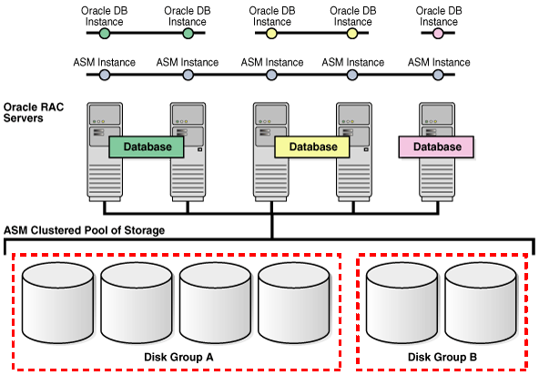
Disk Group Overview
Screen reader hint: This slide contains a diagram that is explained in the speaker notes.
Disk 1
Disk 2
Disk 3
Disk 4
Disk 5
Disk 6
File 3
File 4
File 1
File 2
Notes:
Disk Group Overview
A disk group is a logical grouping of one or more disks that ASM manages as a collection. Each disk group contains the metadata associated with itself. You can think of an ASM disk group as conceptually similar to a logical volume in a typical storage area network.
Files are allocated from the space inside a disk group. The content of files that are stored in a disk group are evenly distributed, or striped, across the disks in the disk group to eliminate hot spots and to provide uniform performance across the disks. Each ASM file is completely contained within a single disk group. However, a disk group can contain files belonging to several databases and a single database can use different files from multiple disk groups.
A key attribute of a disk group is it's redundancy setting. There are three possible disk group redundancy settings:
External redundancy, where ASM does not provide any mirroring and the disks are assumed to highly reliable.
Normal redundancy, where ASM supports 2-way mirroring by default to assure data integrity for less reliable storage.
High redundancy, where ASM supports 3-way mirroring by default for even greater assurance of data integrity.
ASM supports the creation of up to 63 disk groups however for most installations you rarely need more than a few.

Slide 18
ASM Disks
ASM disks:
  Are the storage devices provisioned to ASM disk groups
  Are accessed through normal O/S interfaces
  Must be read and write accessible by the ASM owner
  Must be accessible by all nodes in a cluster
  May have different O/S names or paths on different nodes
  May be:
    An entire physical disk or partition of a physical disk
    A disk or partition from a storage array
    Logical volumes (LV) or logical units (LUN)
    Network-attached files (NFS)
Notes:
Oracle Database 11g: Administration Workshop II D - <number>
ASM Disks
ASM disk groups contain one or more ASM disks.
ASM disks must be read and write accessible by the ASM owner from all nodes in the cluster.
An ASM disk can be a partition on a disk, but Oracle strongly advises against sharing the physical disks used by ASM with other applications. This is because the I/O performance of the ASM disks within a disk group should be similar and consistent for the ASM stripe and mirror policy to work best. Sharing devices between ASM and other applications makes it difficult to assure similar and consistent disk performance.
It is not necessary for the O/S device names of ASM disks on separate nodes in a cluster to be the same. ASM identifies members of a disk group by reading the headers on ASM disks.
Generally, ASM disks are raw LUNs from a storage array presented to ASM. In addition, ASM disks can also be files on a remote NFS filer.

Slide 19
Allocation Units
ASM disks are divided into allocation units (AU):
  AU size is configurable at disk group creation
  Default AU size is 1MB:
    Small enough to be cached by database and large enough for efficient sequential access
  Allowable AU sizes:
    1, 2, 4, 8, 16, 32, or 64 MB.
    Large AUs may be useful in very large database (VLDB) scenarios or when using specialized storage hardware
Notes:
Oracle Database 11g: Administration Workshop II D - <number>
Allocation Units
Within an ASM disk, space is divided into allocation units (AU). The default AU size is one megabyte, which is small enough to not become a hot spot, but large enough to provide efficient sequential access. You can set the AU size when you create a disk group. You cannot change the AU size for a disk group. Larger AU sizes may be useful in very large database (VLDB) scenarios or when using specialized storage hardware. If an AU is constantly accessed, then the database kernel caches it for more efficient access.

Slide 20
ASM Files
ASM files:
  Are a collection of ASM extents composed of AUs
    Variable sized extents support large files
  Appear as normal files to the database kernel
  Have file names that start with '+'
    For example, +DATA/orcl/datafile/system.256.689832921
  May be associated with an optional alias file name
    For example, +DATA/dbfiles/mydb/system01.dbf
  Are evenly distributed across disks in a disk group
  Are mirrored according to the policies defined in the disk group
Notes:
Oracle Database 11g: Administration Workshop II D - <number>
ASM Files
ASM exposes a set of files for use by clients of ASM. An ASM file is composed of a set of allocation units and appears as a normal file to the database kernel.
Each ASM File has a unique system-generated name. The slide shows and example of a fully-qualified ASM file name. The fully-qualified ASM file name represents a hierarchy beginning with a concatenation of a plus sign with the disk group name. Following the disk group name is the database name and file type. The final element is composed of a tag name, file number and incarnation number. An alias can optionally be created to give administrators a more user-friendly means of referring to an ASM file.
Files are evenly spread across the ASM disks in a disk group using the policy of stripe and mirror everything (SAME).
ASM natively supports most database related file types, such as data files, log files, control files, RMAN backups, and others. Prior to Oracle Database 11g Release 2, ASM only supported Oracle database related files and could not be used to store and manage ASCII trace files and alert logs, Oracle binaries, the Oracle cluster registry (OCR), and the cluster voting disk. Oracle Database 11g Release 2 removes this restriction by providing the means to run a general purpose file system over ASM.

Slide 21
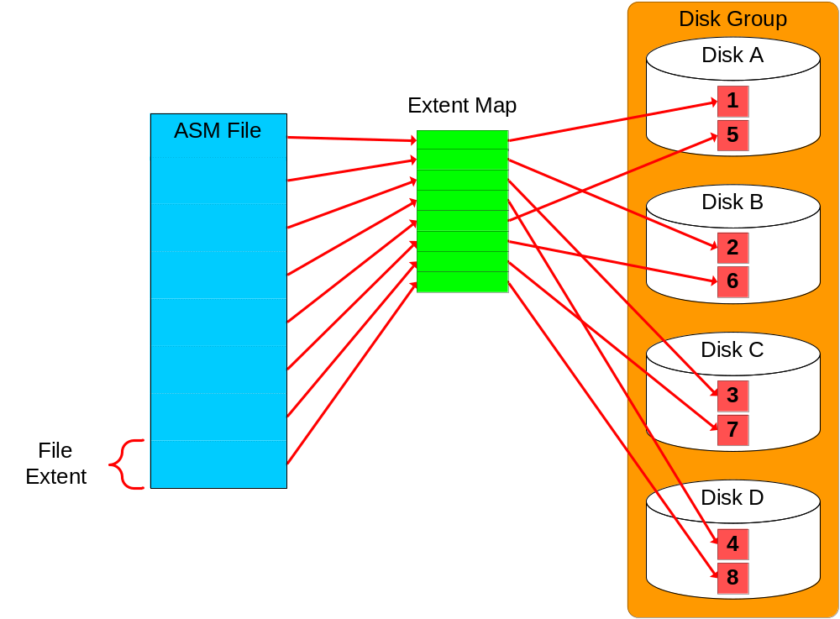
Extent Maps
Notes:
Oracle Database 11g: Administration Workshop II D - <number>
Extent Maps
ASM keeps track of a file’s layout with metadata called an extent map. An extent map is a table that maps data extents in a file to allocation units on disk.
The relationship between file extents and allocation units is as follows. An extent contains:
One AU for the first 20,000 extents (0–19999)
4 AUs for the next 20,000 extents (20000–39999)
16 AUs for extents above 40,000
Variable size extents, coupled with large allocation units, can be used to accommodate very large ASM files.

Slide 22
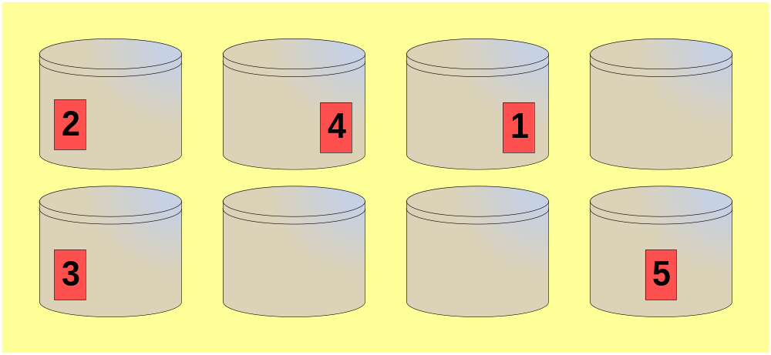
Striping Granularity
ASM separates striping for load balance and striping for latency:
  Coarse grain striping concatenates allocation units for load balancing.
    For example:
ASM Disk Group
Notes:
Oracle Database 11g: Administration Workshop II D - <number>
Striping Granularity
In ASM striping has two primary purposes:
Load balance I/O across all the disks in a disk group.
Improve I/O latency.
Coarse grain striping spreads allocation units across the disks in a disk group. This is what provides load balancing for disk groups. When a file is allocated, ASM spreads allocation units evenly across all of the disks. Sometimes the distribution cannot be perfectly even, but over time it will tend to be nearly equal. The above diagram shows a file with five allocation units striped across five disks in an external redundancy disk group containing 8 disks in total.
For the first 20,000 extents, the extent size is equal to the AU size. After 20,000 extents and up to 40,000 extents, then extent sets are always allocated 8 at a time with the extent size equal to 4*AU size. If the AU size is 1 MB, this means the ASM file will grow 64 MB at a time (8 * 4 * 1 MB). If the file is coarse grained striped then it is striped across the 8 extent sets with stripes of 1 AU. Striping is always done at the AU level, not at the extent level. Thus every AU of a coarse grained file is on a different disk than the previous AU of that file no matter how large the file. After 40,000 extents, the extents are still allocated 8 at a time, but with an extent size equal to 16*AU size.

Slide 23
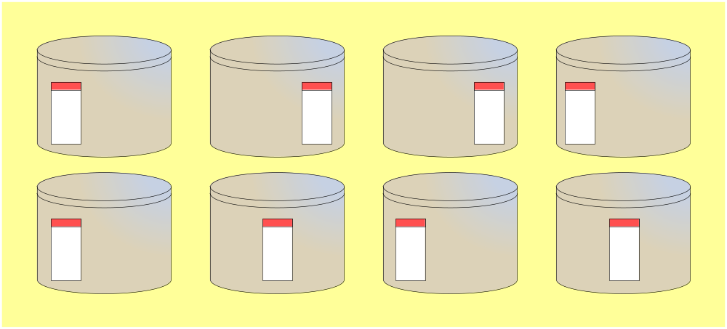
Fine Grained Striping
Fine grain striping puts 128 KB stripe units across groups of allocation units to improve latency.
  Disk group with 8 disks and external redundancy
  Default AU size of 1 MB in use
  First 1 MB extent written as 128 KB stripes across 8 AUs
ASM Disk Group
Notes:
Oracle Database 11g: Administration Workshop II D - <number>
Fine Grained Striping
Fine grain striping splits data extents into 128 KB chunks and it is provided to improve latency for certain types of files by spreading the load for each extent across a number of disks. Fine grain striping is used by default for control files and online redo log files.
The diagram on this page shows how fine grain striping works. In this example, the first 1 MB extent of a new file ends up occupying the first 128 KB of 8 different allocation units spread across the eight disks in the disk group. Consequently, a one megabyte read or write is spread across eight disks instead of one...

Slide 24
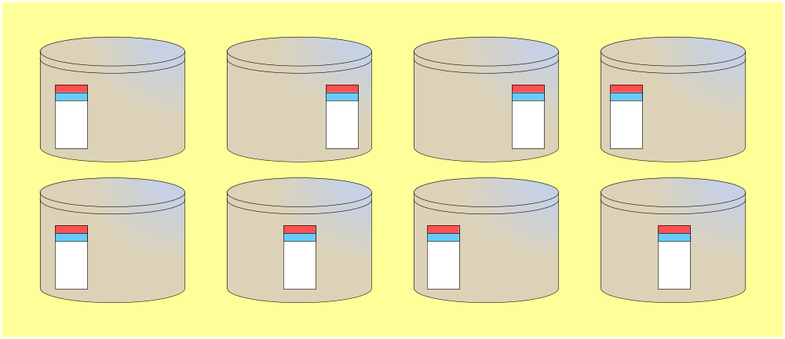
Fine Grained Striping
Example:
  Disk group with 8 disks and external redundancy.
  Default AU size of 1 MB in use.
  Next 1 MB extent written as 128 KB stripes across the same 8 allocation units until they are full.
ASM Disk Group
Notes:
Oracle Database 11g: Administration Workshop II D - <number>
Fine Grained Striping (continued)
Continuing the previous example, the next one megabyte extent of space is spread across the second 128 KB of each of the same allocation units. This pattern continues until the first set of allocation units is filled and another set in allocated.

Slide 25
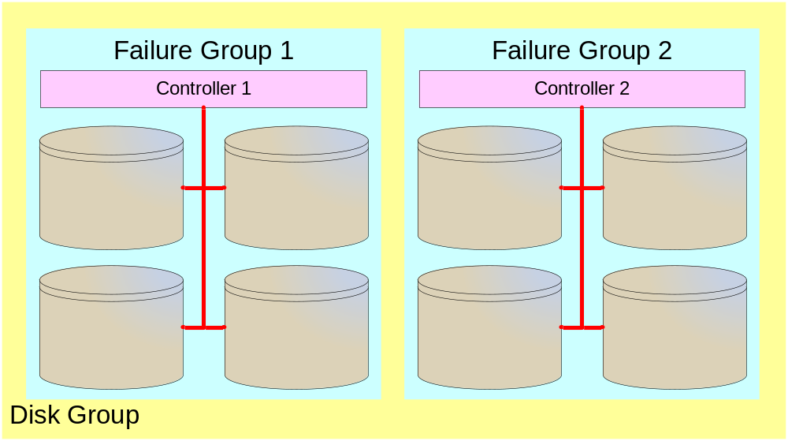
ASM Failure Groups
  A set of disks sharing a common resource whose failure needs to be tolerated.
  Mirrored extent copies stored in separate failure groups.
  Storage hardware dictates failure group boundaries.
    Example based on isolating disk controllers:
Notes:
Oracle Database 11g: Administration Workshop II D - <number>
ASM Failure Groups
Within a disk group, disks may be collected into failure groups. Failure groups are the way a storage or database administrator specifies the hardware boundaries that ASM mirroring operates across.
For example, all the disks attached to a single disk controller could be specified to be within a common failure group. This would lead to file extents being mirrored on disks connected to separate controllers. Additionally, an administrator can configure ASM to chose a default failure group policy. The default policy is that each individual disk is in its own failure group.
You can group disks into failure groups using whatever criteria you need. Failure groups can be used to protect from the failure of individual disks, disk controllers, I/O network components and even entire storage systems. Typically, an administrator would analyze their storage environment and would organize failure groups to mitigate against specific failure scenarios.
It is up to the database or storage administrator to determine what is the best failure group configuration for their installation.

Slide 26
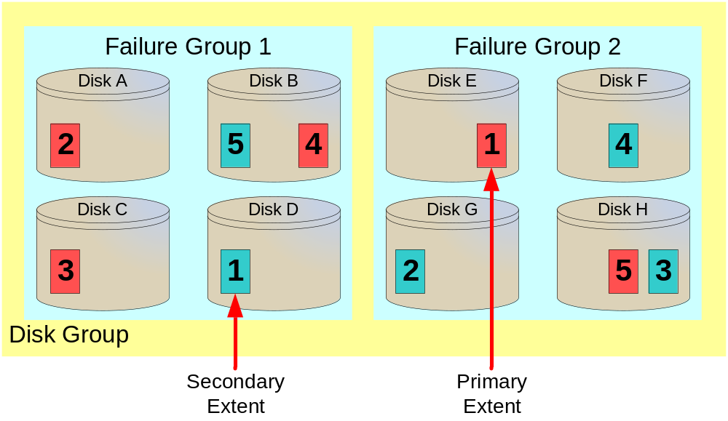
Stripe and Mirror Example
Normal redundancy disk group with 8 disks in total, spread across two failure groups.
Notes:
Oracle Database 11g: Administration Workshop II D - <number>
Stripe and Mirror Example
The diagram on this page illustrates and example showing striping and mirroring in a normal redundancy disk group. The red blocks represent a file with five extents being striped across five of the eight disks in the disk group. The blue blocks represent mirrored copies of the file’s extents. Note that regardless of the distribution of extents across the various disks and failure groups, each extent has exactly one copy in each failure group.
When a file is allocated, the primary extents are allocated for performance and the secondary copies are allocated for integrity. For this reason all database reads are made against the primary extents by default.

Slide 27
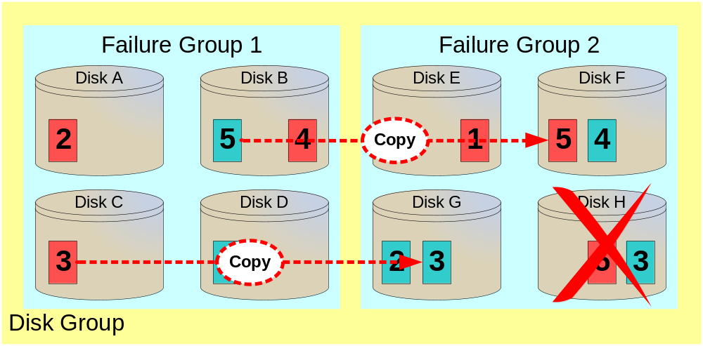
Failure Example
If disk H fails, then the extents it contained are re-created on surviving disks from surviving mirrors.
Notes:
Oracle Database 11g: Administration Workshop II D - <number>
Failure Example
Extending the example on the previous page, imagine that disk H fails and the data it contains is no longer accessible. This failure requires that all the extents on the failed disk need to be recovered and copied to another disk.
Extents three and five are copied from the surviving copy to a free region on another disk in the same failure group. In this example, extent five is copied from disk B to Disk F and extent three is copied from Disk C to Disk G.
The last step after a disk fails is that ASM drops the failed disk from the disk group.
The removal of a disk triggers essentially the same process, however in that case the extents on the disk being removed are first copied to an available alternative location.

Slide 28

Managing Disk Groups
CREATE DISKGROUP
ASM
instance
DROP DISKGROUP
Database
instance
ALTER DISKGROUP
Notes:
Oracle Database 11g: Administration Workshop II D - <number>
Managing Disk Groups
The main goal of an ASM instance is to manage disk groups and protect their data. ASM instances also communicate file layout to database instances. In this way, database instances can directly access files stored in disk groups.
There are several disk group administrative commands. They all require the SYSASM or SYSDBA privilege and must be issued from an ASM instance.
You can add new disk groups. You can also modify existing disk groups to add new disks, remove existing ones, and perform many other operations. You can remove existing disk groups.

Slide 29
Creating and Dropping Disk Groups
Using SQL*Plus
$ . oraenv
ORACLE_SID = [orcl] ? +ASM
The Oracle base for ORACLE_HOME=/u01/app/oracle/product/11.2.0/grid is /u01/app/oracle
$ sqlplus / AS SYSASM
SQL*Plus: Release 11.2.0.1.0 - Production on Wed Jul 8 20:46:46 2009
Copyright (c) 1982, 2009, Oracle. All rights reserved.
Connected to an idle instance.
SQL> CREATE DISKGROUP dgroupA NORMAL REDUNDANCY
FAILGROUP controller1 DISK
'/devices/A1' NAME diskA1 SIZE 120G FORCE,
'/devices/A2',
FAILGROUP controller2 DISK
'/devices/B1',
'/devices/B2';
SQL> DROP DISKGROUP dgroupA INCLUDING CONTENTS;
Notes:
Oracle Database 11g: Administration Workshop II D - <number>
Creating and Dropping Disk Groups
Assume that ASM disk discovery identified the following disks in the /dev directory: A1, A2, B1, and B2. Also, assume that disks A1 and A2 are on a separate disk controllers from disks B1 and B2. The first example in the slide illustrates how to configure a disk group called DGROUPA with two failure groups: CONTROLLER1 and CONTROLLER2.
The example also uses the default redundancy attribute, NORMAL REDUNDANCY, for the disk group. You can optionally provide a disk name and size for the disk. If you do not supply this information, ASM creates a default name and attempts to determine the size of the disk. If the size cannot be determined, an error is returned. FORCE indicates that a specified disk should be added to the specified disk group even though the disk is already formatted as a member of an ASM disk group. Using the FORCE option for a disk that is not formatted as a member of an ASM disk group returns an error.
As shown by the second statement in the slide, you can delete a disk group along with all its files. To avoid accidental deletions, the INCLUDING CONTENTS option must be specified if the disk group still contains any files besides internal ASM metadata. The disk group must be mounted in order for it to be dropped. After ensuring that none of the disk group files are open, the group and all its drives are removed from the disk group. Then the header of each disk is overwritten to eliminate the ASM formatting information.

Slide 30
Adding Disks to Disk Groups
ALTER DISKGROUP dgroupA ADD DISK
'/dev/sde1' NAME A5,
'/dev/sdf1' NAME A6,
'/dev/sdg1' NAME A7,
'/dev/sdh1' NAME A8;
ALTER DISKGROUP dgroupA ADD DISK '/devices/A*';
Disk formatting
Disk group rebalancing
Notes:
Oracle Database 11g: Administration Workshop II D - <number>
Adding Disks to Disk Groups
This example shows how to add disks to a disk group. You execute an ALTER DISKGROUP ADD DISK command to add the disks. The first statement adds four new disks to the DGROUPA disk group.
The second statement demonstrates the interactions of discovery strings. Consider the following configuration:
/devices/A1 is a member of disk group DGROUPA.
/devices/A2 is a member of disk group DGROUPA.
/devices/A3 is a member of disk group DGROUPA.
/devices/A4 is a candidate disk.
The second command adds A4 to the DGROUPA disk group. It ignores the other disks, even though they match the discovery string, because they are already part of the DGROUPA disk group. The diagram shows that, when you add a disk to a disk group, the ASM instance ensures that the disk is addressable and usable. The disk is then formatted and rebalanced. The rebalance process is time consuming because it moves extents from all files onto the new disk.
Note: Rebalancing does not block any database operations. The main impact that a rebalance process has is on the I/O load on the system. The higher the power of the rebalance, the more I/O load it puts on the system. Thus less I/O bandwidth is available for database I/Os.

Slide 31
Miscellaneous ALTER Commands
  Remove a disk from dgroupA:
  Add and drop a disk in a single command:
  Cancel a disk drop operation:
ALTER DISKGROUP dgroupA DROP DISK A5;
ALTER DISKGROUP dgroupA
DROP DISK A6
ADD FAILGROUP controller3
DISK '/dev/sdi1' NAME A9;
ALTER DISKGROUP dgroupA UNDROP DISKS;
Notes:
Oracle Database 11g: Administration Workshop II D - <number>
Miscellaneous ALTER Commands
The first statement in the slide shows how to remove one of the disks from the DGROUPA disk group. The second statement shows how you can add and drop a disk in a single command. The big advantage in this case is that rebalancing is not started until the command completes. The third statement shows how to cancel a disk drop operation. The UNDROP command operates only on pending drops of disks; it has no effect on drops that have completed.
The following statement rebalances the DGROUPB disk group, if necessary:
ALTER DISKGROUP dgroupB REBALANCE POWER 5;
This command is generally not necessary because it is automatically done as disks are added, dropped, or resized. However, it is useful if you want to use the POWER clause to override the default speed defined by the initialization parameter ASM_POWER_LIMIT. You can change the power level of an ongoing rebalance operation by reentering the command with a new level. A power level of zero causes rebalancing to halt until the command is either implicitly or explicitly reinvoked. The following statement dismounts DGROUPA:
ALTER DISKGROUP dgroupA DISMOUNT;
The MOUNT and DISMOUNT options allow you to make one or more disk groups available or unavailable to the database instances. The ability to manually unmount and mount is useful in a clustered ASM environment supporting a single instance, when that instance is failed over to a different node.

Slide 32
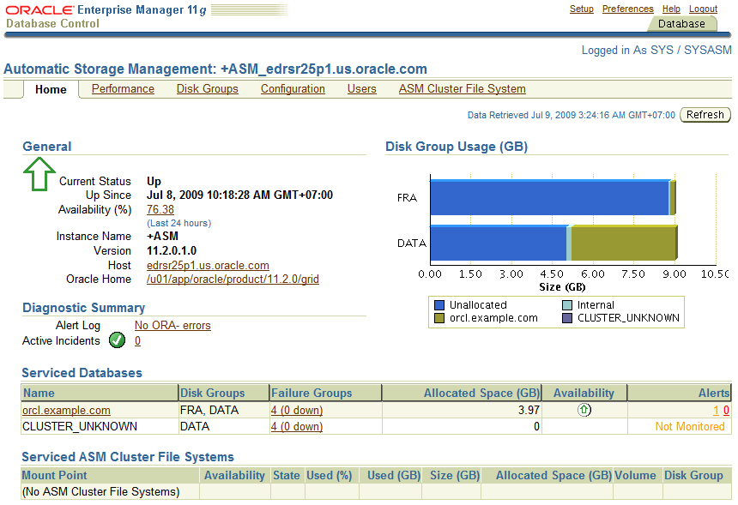
ASM Management Using Enterprise Manager
Notes:
Oracle Database 11g: Administration Workshop II D - <number>
ASM Management Using Enterprise Manager
Oracle Enterprise Manager (EM) is Oracle’s family of management tools spanning database, middleware, applications, networks, IT infrastructure and more. Enterprise Manager delivers a browser based environment that provides a point and click alternative for common ASM administration tasks.

Slide 33
ASM Disk Group Compatibility
  Compatibility of each disk group is separately controllable:
    ASM compatibility controls ASM metadata on-disk structure
    RDBMS compatibility controls minimum consumer client level
    ADVM compatibility determines whether a disk group can contain Oracle ASM volumes
  Setting disk group compatibility is irreversible.
DB
instance
ASM disk
group
ASM
instance
COMPATIBLE
>=
COMPATIBLE.RDBMS
<=
COMPATIBLE.ASM
<=
COMPATIBLE
>=
COMPATIBLE.ADVM
Notes:
ASM Disk Group Compatibility
There are three kinds of compatibility applicable to ASM disk groups; dealing with the persistent data structures that describe a disk group, the capabilities of the clients (consumers of disk groups), and the ability to contain volumes in a disk group. These attributes are called ASM compatibility , RDBMS compatibility, and ADVM compatibility respectively. The compatibility of each disk group is independently controllable. This is required to enable heterogeneous environments with disk groups from both Oracle Database 10g and Oracle Database 11g. These three compatibility settings are attributes of each ASM disk group:
RDBMS compatibility refers to the minimum compatible version of the RDBMS instance that would allow the instance to mount the disk group. This compatibility dictates the format of messages that are exchanged between the ASM and database (RDBMS) instances. An ASM instance has the capability to support different RDBMS clients running at different compatibility settings. The database compatible version setting of each instance must be greater than or equal to the RDBMS compatibility of all disk groups used by that database. Database instances are typically run from a different Oracle home than the ASM instance. This implies that the database instance may be running a different software version than the ASM instance. When a database instance first connects to an ASM instance, it negotiates the highest version that they both can support.

Slide 34
ASM Disk Group Compatibility
Full Notes Page
Notes:
ASM Disk Group Compatibility (continued)
The compatibility parameter setting of the database, software version of the database, and the RDBMS compatibility setting of a disk group determine whether a database instance can mount a given disk group.
ASM compatibility refers to the persistent compatibility setting controlling the format of data structures for ASM metadata on disk. The ASM compatibility level of a disk group must always be greater than or equal to the RDBMS compatibility level of the same disk group. ASM compatibility is concerned only with the format of the ASM metadata. The format of the file contents is up to the database instance. For example, the ASM compatibility of a disk group can be set to 11.0 while its RDBMS compatibility could be 10.1. This implies that the disk group can be managed only by ASM software whose software version is 11.0 or higher, whereas any database client whose software version is higher than or equal to 10.1 can use that disk group.
The ADVM compatibility attribute determines whether the disk group can contain Oracle ASM volumes in the disk group. The value must be set to 11.2 or higher. Before setting this attribute, the COMPATIBLE.ASM value must be 11.2 or higher. Also, the ADVM volume drivers must be loaded.
The compatibility of a disk group needs to be advanced only when there is a change to either persistent disk structures or protocol messaging. However, advancing disk group compatibility is an irreversible operation. You can set the disk group compatibility by using either the CREATE DISKGROUP or ALTER DISKGROUP commands.
Note: In addition to the disk group compatibilities, the compatible parameter (database compatible version) determines the features that are enabled; it applies to the database or ASM instance depending on the instance_type parameter. For example: Setting it to 10.1 would preclude use of any features introduced in Oracle Database 11g (disk online/offline, variable extents, and so on).

Slide 35
ASM Disk Group Attributes
Name | Property | Values | Description
au_size | Create, Alter | 1|2|4|8|16|32|64MB | Size of allocation units in the disk group
compatible.rdbms | Create, Alter | Valid database version | Format of messages exchanged between DB and ASM
compatible.asm | Create, Alter | Valid ASM instance version | Format of ASM metadata structures on disk
compatible.advm | Create, Alter | Valid ASM instance version | Allows Oracle ASM volumes in disk group
disk_repair_time | Create, Alter | 0 M to 2³² D | Length of time before removing a disk once OFFLINE
template.tname. redundancy | Alter | UNPROTECT|MIRROR|HIGH | Redundancy of specified template
template.tname. stripe | Alter | COARSE|FINE | Striping attribute of specified template
CREATE DISKGROUP DATA2 NORMAL REDUNDANCY
DISK '/dev/sda1','/dev/sdb1'
ATTRIBUTE 'compatible.asm'='11.2';
Notes:
ASM Disk Group Attributes
Whenever you create or alter an ASM disk group, you have the ability to change its attributes using the new ATTRIBUTE clause of the CREATE DISKGROUP and ALTER DISKGROUP commands. These attributes are briefly summarized in the table given in the slide:
ASM enables the use of different allocation unit (AU) sizes that you specify when you create a disk group. The AU can be 1, 2, 4, 8, 16, 32, or 64 MB in size.
RDBMS compatibility: See the slide “ASM Disk Group Compatibility” for more information.
ASM compatibility: See the slide “ASM Disk Group Compatibility” for more information.
You can specify the DISK_REPAIR_TIME in units of minute (M), hour (H), or day (D). If you omit the unit, then the default is H. If you omit this attribute, then the default is 3.6H. You can override this attribute with an ALTER DISKGROUP ... DISK OFFLINE statement.
You can also specify the redundancy attribute of the specified template.
You can also specify the striping attribute of the specified template.
Note: For each defined disk group, you can look at all defined attributes through the V$ASM_ATTRIBUTE fixed view.

Slide 36
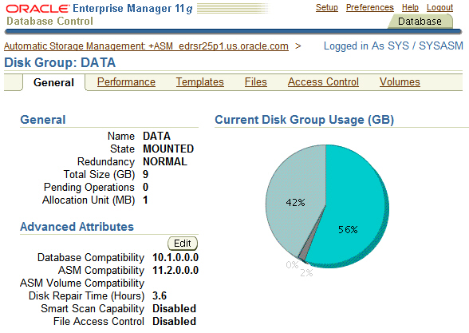
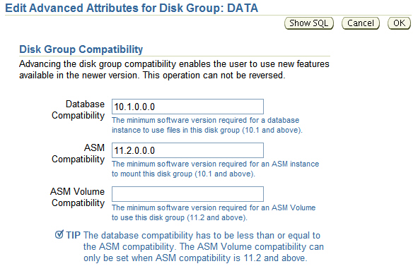
Using Enterprise Manager to
Edit Disk Group Attributes
Notes:
Using Enterprise Manager to Edit Disk Group Attributes
Enterprise Manager provides a simple way to store and retrieve environment settings related to disk groups.
You can set the compatible attributes from both the create disk group page and the edit disk group advanced attributes page. The disk_repair_time attribute is added to only edit the disk group advanced attributes page.
Note: For pre-11g ASM instances, the default ASM compatibility and the client compatibility are each 10.1. For 11g ASM instances, the default ASM compatibility is 11.2 and the database compatibility is 10.1.

Slide 37
Retrieving ASM Metadata
  Using SQL*Plus
  Using asmcmd
SQL> SELECT f.type, f.redundancy, f.striped, f.modification_date, a.system_created, a.name FROM v$asm_alias a, v$asm_file f WHERE a.file_number = f.file_number and a.group_number = f.group_number and type='DATAFILE';
TYPE REDUND STRIPE MODIFICAT S NAME
-------- ------ ------ --------- - ---------------------
DATAFILE MIRROR COARSE 08-JUL-09 Y SYSTEM.256.689832921
DATAFILE MIRROR COARSE 08-JUL-09 Y SYSAUX.257.689832923
..
ASMCMD> ls -l +DATA/orcl/datafile
Type Redund Striped Time Sys Name
DATAFILE MIRROR COARSE JUL 08 21:00:00 Y SYSTEM.256.689832921
DATAFILE MIRROR COARSE JUL 08 21:00:00 Y SYSAUX.257.689832923
..
Notes:
Oracle Database 11g: Administration Workshop II D - <number>
Retrieving ASM Metadata
The ASM instance hosts memory-based metadata tables presented as dynamic performance views. This data can be queried using SQL*Plus, asmcmd, or Enterprise Manager.
Using SQL*Plus requires knowledge of the SQL language and may involve join multiple dynamic performance views to retrieve relevant information. This first example on the slide shows a join between v$asm_file and v$asm_alias to display metadata regarding the data files of a database. If this query is performed against the ASM instance, it could retrieve data files from multiple databases they way the syntax is designed. You would need to use additional filter conditions to restrict the output to a single database.
The asmcmd utility has the advantage of being able to connect to the ASM instance and retrieve metadata without knowledge of the SQL language. It used a style similar to Unix notation. The second example on this slide uses asmcmd to retrieve the same metadata as the SQL example did. Another advantage of this example is that the output is restricted to the data files of a single database since the path that is being listed contains the database name of orcl, and the file type of data file. Therefore, what appears as directories in asmcmd would require SQL filter conditions using the WHERE clause to give the same result.
Note: Enterprise Manager Database Control is able to display most of the ASM metadata by simply navigating among the various ASM web pages.

Slide 38




ASM Fast Mirror Resync Overview
1
ASM redundancy is used
2
Disk access failure
Primary
extent
Secondary
extent
Oracle Database 11g
Disk again accessible:
Only need to resync modified extents
4
Failure time < DISK_REPAIR_TIME
3
Notes:
ASM Fast Mirror Resync Overview
ASM fast mirror resync significantly reduces the time required to resynchronize a transient failure of a disk. When a disk goes offline following a transient failure, ASM tracks the extents that are modified during the outage. When the transient failure is repaired, ASM can quickly resynchronize only the ASM disk extents that have been affected during the outage.
This feature assumes that the content of the affected ASM disks has not been damaged or modified.
When an ASM disk path fails, the ASM disk is taken offline but not dropped if you have set the DISK_REPAIR_TIME attribute for the corresponding disk group. The setting for this attribute determines the duration of a disk outage that ASM tolerates while still being able to resynchronize after you complete the repair.
Note: The tracking mechanism uses one bit for each modified allocation unit. This ensures that the tracking mechanism very efficient.

Slide 39
Summary
In this lesson, you should have learned how to:
  Manage the ASM instance using SQL*plus, asmcmd, and Enterprise Manager
  Create and drop ASM disk groups
  Specify ASM compatibility attributes
  Extend ASM disk groups
  Compare methods of retrieving ASM metadata
Notes:
Oracle Database 11g: Administration Workshop II D - <number>

